Slide 1
Experiment two
Lee's disc method for determine the thermal conductivity of a bad conductor.
Aim: To measure the thermal conductivity coefficient of bad conductor.

Slide 2
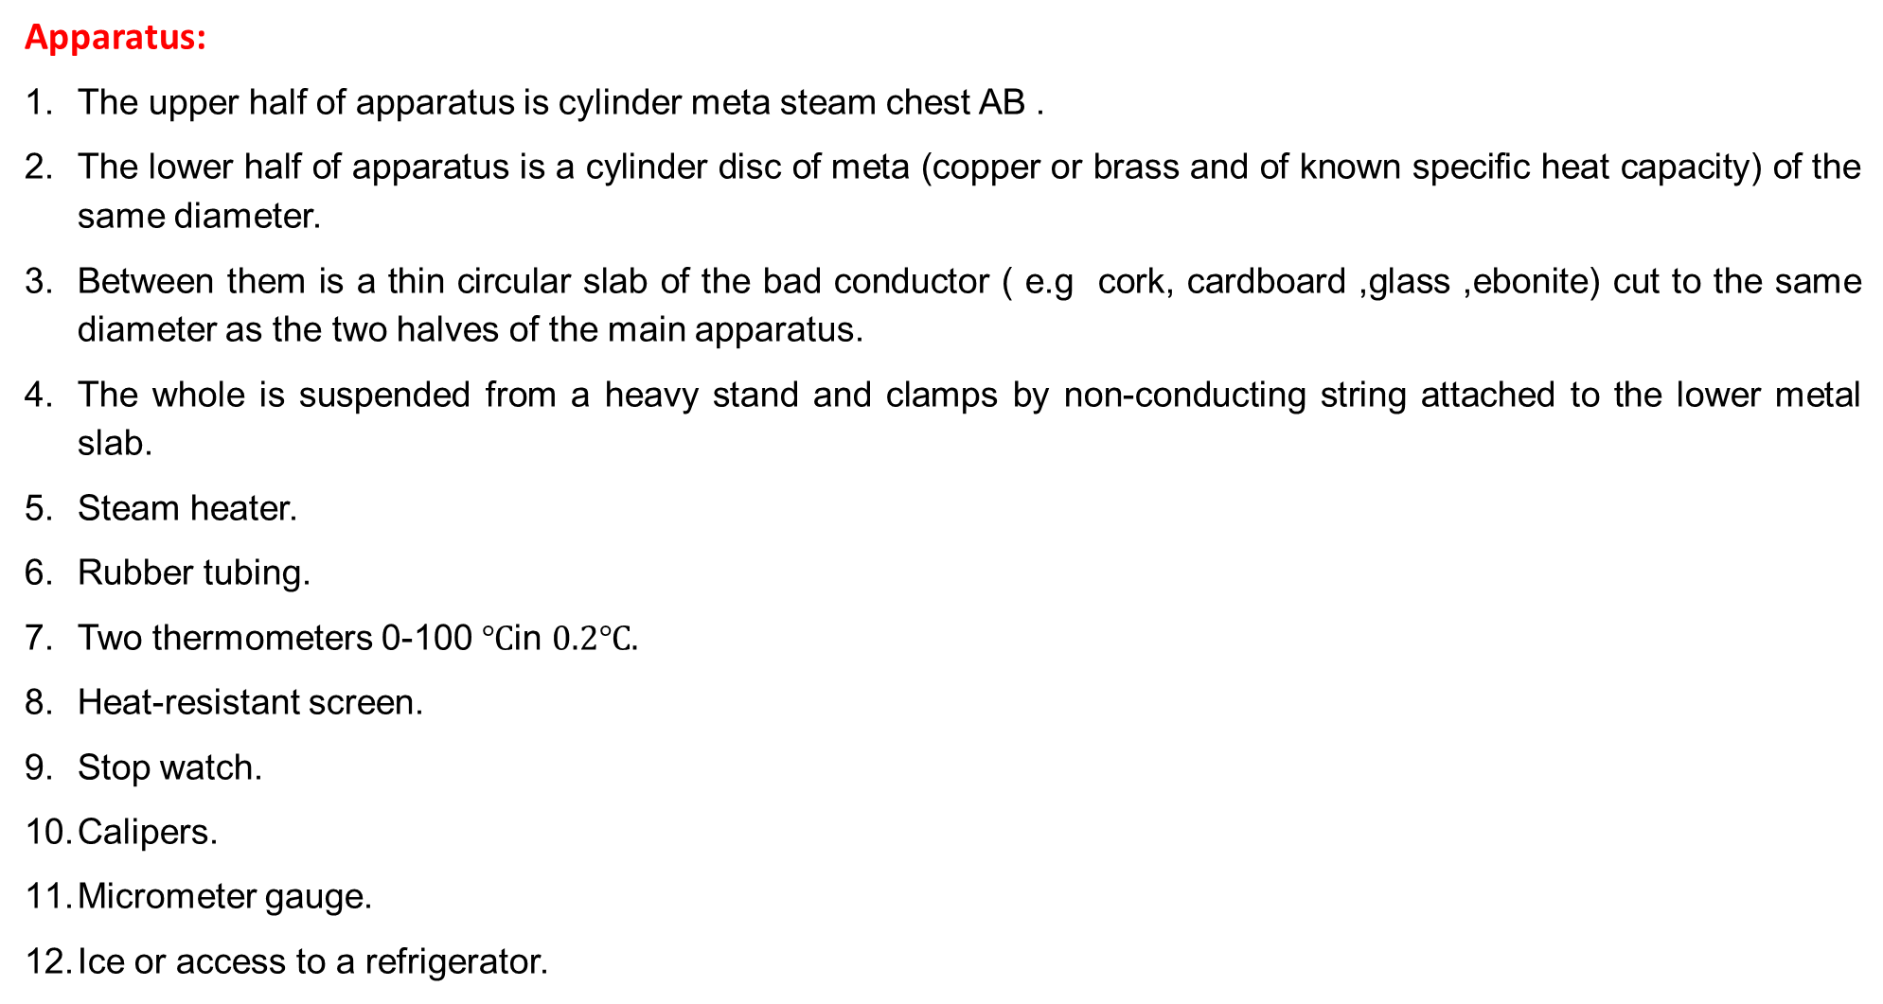
Apparatus:
The upper half of apparatus is cylinder meta steam chest AB .
The lower half of apparatus is a cylinder disc of meta (copper or brass and of known specific heat capacity) of the same diameter.
Between them is a thin circular slab of the bad conductor ( e.g cork, cardboard ,glass ,ebonite) cut to the same diameter as the two halves of the main apparatus.
The whole is suspended from a heavy stand and clamps by non-conducting string attached to the lower metal slab.
Steam heater.
Rubber tubing.
Two thermometers 0-100 $℃$in $0.2℃.$
Heat-resistant screen.
Stop watch.
Calipers.
Micrometer gauge.
Ice or access to a refrigerator.

Slide 3
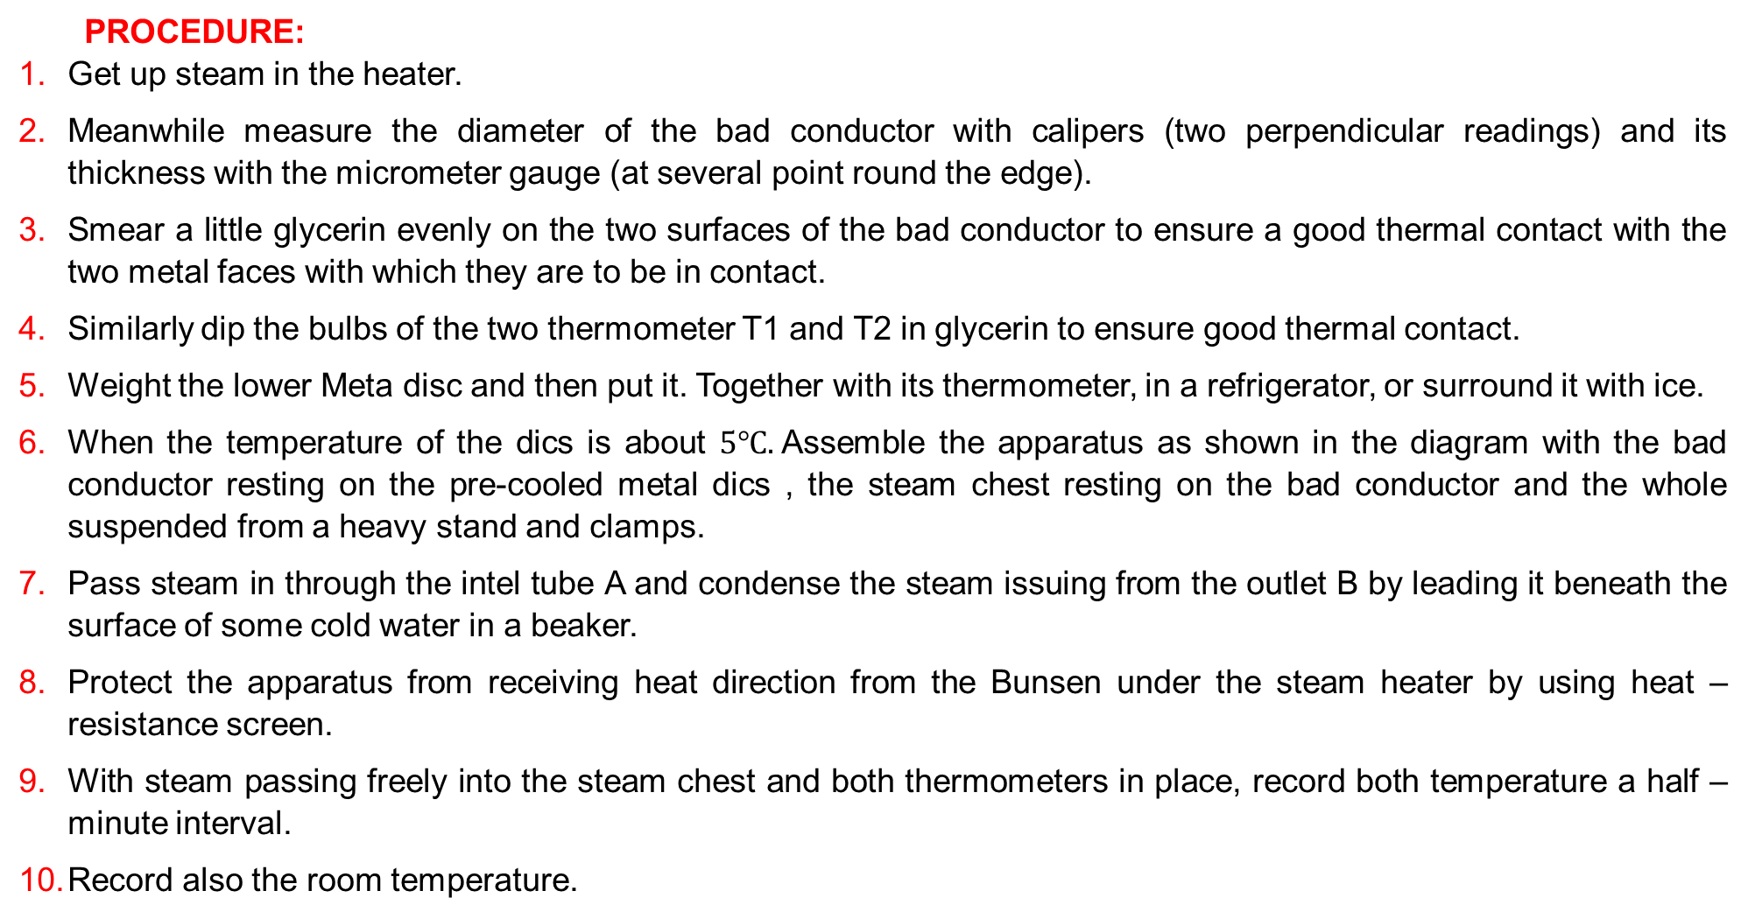
PROCEDURE:
Get up steam in the heater.
Meanwhile measure the diameter of the bad conductor with calipers (two perpendicular readings) and its thickness with the micrometer gauge (at several point round the edge).
Smear a little glycerin evenly on the two surfaces of the bad conductor to ensure a good thermal contact with the two metal faces with which they are to be in contact.
Similarly dip the bulbs of the two thermometer T1 and T2 in glycerin to ensure good thermal contact.
Weight the lower Meta disc and then put it. Together with its thermometer, in a refrigerator, or surround it with ice.
When the temperature of the dics is about $5℃.$Assemble the apparatus as shown in the diagram with the bad conductor resting on the pre-cooled metal dics , the steam chest resting on the bad conductor and the whole suspended from a heavy stand and clamps.
Pass steam in through the intel tube A and condense the steam issuing from the outlet B by leading it beneath the surface of some cold water in a beaker.
Protect the apparatus from receiving heat direction from the Bunsen under the steam heater by using heat –resistance screen.
With steam passing freely into the steam chest and both thermometers in place, record both temperature a half –minute interval.
Record also the room temperature.

